Slide 1
Heteroskedasticity

Slide 2
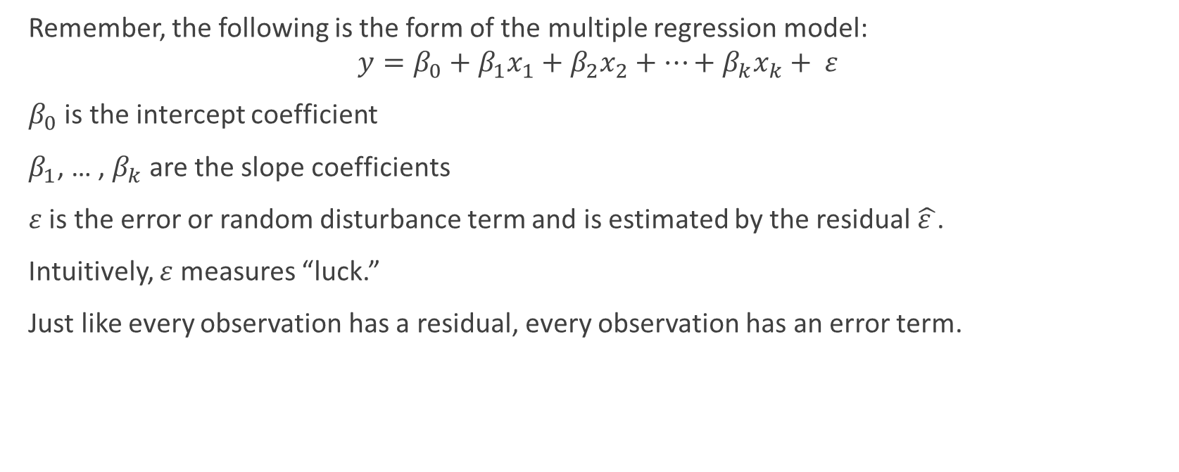
The Error Term
Remember, the following is the form of the multiple regression model:
$$y=β_{0}+β_{1}x_{1}+β_{2}x_{2}+…+β_{k}x_{k}+ ε$$
$β_{0}$ is the intercept coefficient
$β_{1}$, … , $β_{k}$ are the slope coefficients
$ε$ is the error or random disturbance term and is estimated by the residual $\hat{ε }$.
Intuitively, $ε$ measures “luck.”
Just like every observation has a residual, every observation has an error term.

Slide 3
Homoskedasticity
The statistical theory that regression is based upon assumes that Var (ε)is the same for all observations. This is known as the “equal variance” or homoskedasticity assumption.
This assumption is actually more the exception than the rule.
Most data sets are characterized by heteroskedasticty or an unequal variance of the error term across observations.

Slide 4
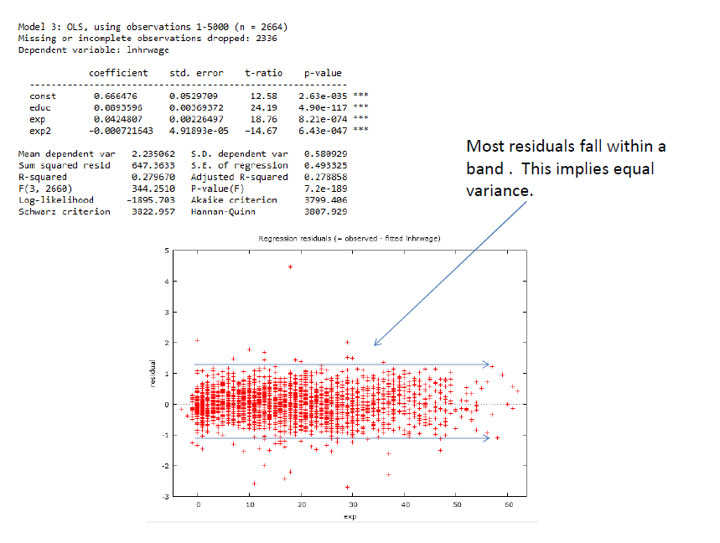

Slide 5
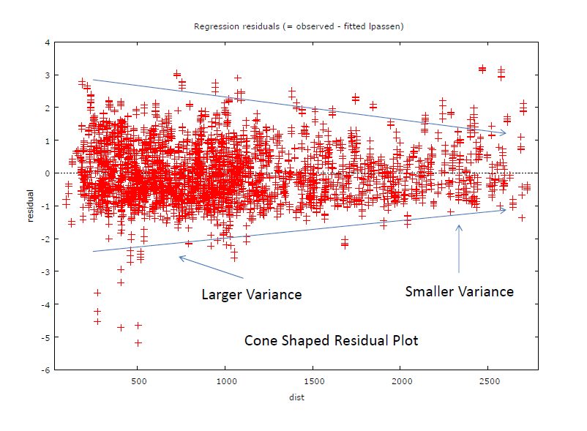

Slide 6
Consequences of Heteroskedasticity
When there is unequal variances across observations, the standard error of the estimated slope coefficients (and as a result the t-stats) are calculated incorrectly.
The statistical significance of the estimated coefficients is thus reported incorrectly.
Most regression programs can “correct” for the presence of heteroskedasticity with the click of a button.

Slide 7
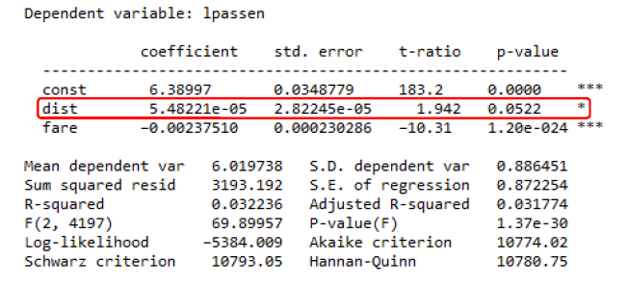
Example: Explaining the amount of Passengers on Airline Flights
Dependent Variable: Log of the number of passengers (lpassen)
Explanatory Variables: Distance in miles (dist) and one way fare in dollars (fare).

Slide 8
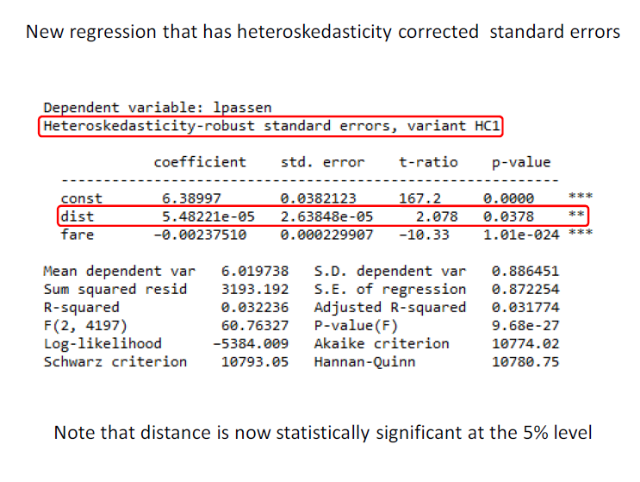

Slide 9
Correcting for Heteroskedasticity
Note that when you correct for heteroskedasticity it only affects the standard errors, t-stats, and p- values.
The estimated coefficients and R² remain unchanged.
As a general rule, you should assume that the model exhibits heteroskedasticity and correct for it.
It is unlikely for a model to not have any form of heteroskedasticity.

